Slide 1
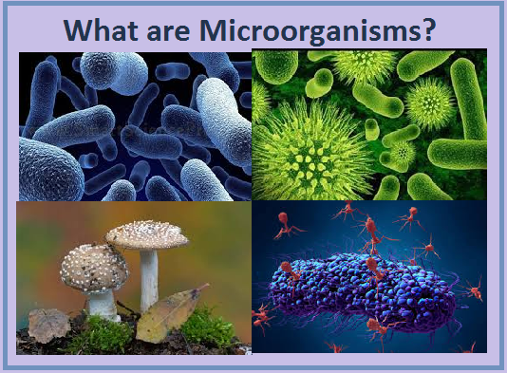
Microorganisms

Slide 2
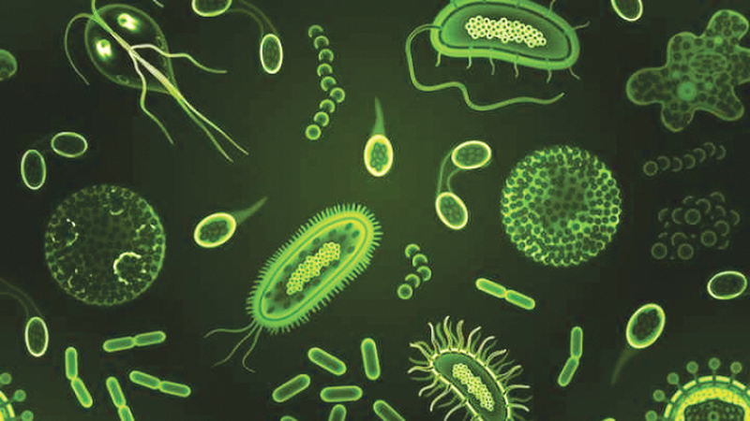
MICROORGANISM
Living organisms which are microscopic, i.e., they are not visible to naked eye are called microorganisms or microbes
Characteristic features
microscopic i.e., small in size
exists as acellular entities, unicellular, multicellular or cell clusters
Extremely diverse/ cosmopolitan
can be either prokaryotic or eukaryotic
have fast rate of reproduction
have fast rate of evolution (results in development of multidrug resistant pathogenic bacteria)
Notes:
Note: A typical virus measures about 100 nm, 10 times smaller than a typical bacterium (~1 µm), which is at least 10 times smaller than a typical plant or animal cell (~10–100 µm).
An object must measure about 100 µm to be visible without a microscope.

Slide 3
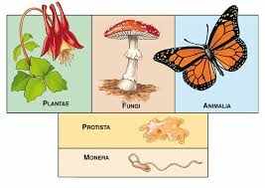
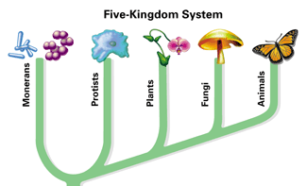
PLACE OF MICROORGANISM IN LIVING WORLD
Micro-organism
Fungi
Animal
Monera
Protista
Plantae
Prokaryotes
Eukaryotes

Slide 4
HABITAT
Occupy almost every habitat from the poles to the equator, deserts, geysers, rocks and the deep sea.
Some are adapted to extremes (extremophiles) such as very hot or very cold conditions, others to high pressure and a few such to high radiation environments.

Slide 5
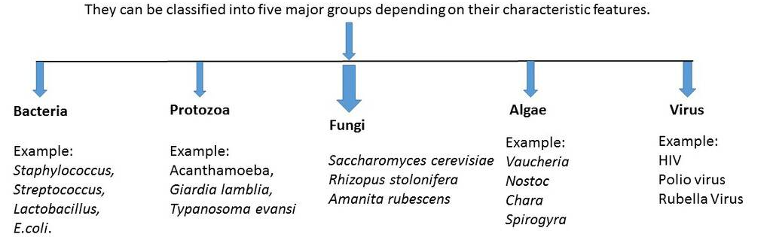
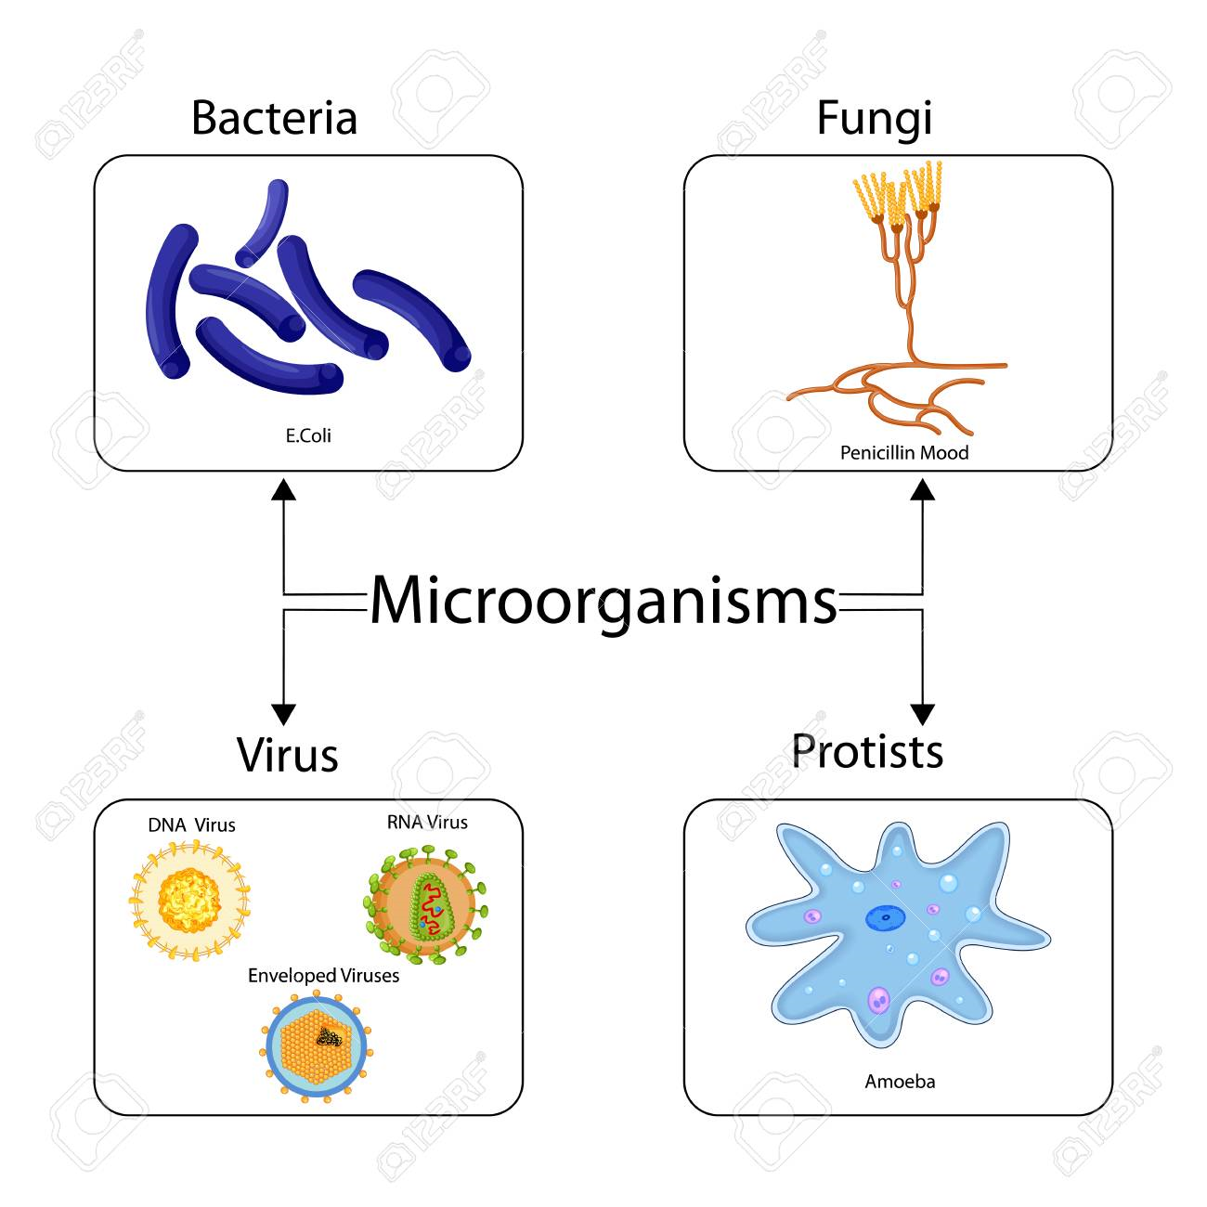
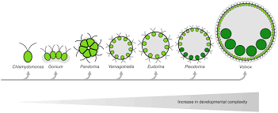
TYPES of microorganism
Notes:
Bacteria
Prokaryotic, unicellular organisms
Have cell wall (peptidoglycan) but no nucleus.
Some are autotrophs but most are heterotrophs.
Found in different shapes; like rod-shaped, spiral, spherical and comma-shaped.
Examples: Rhizobium, E. coli, Pseudomonas, Streptococcus, etc.
Example of autotrophic bacteria - cyanobacteria (blue-green algae)
Protozoa
Eukaryotic, unicellular organisms
Do not have cell wall and chloroplast but they do have nucleus.
Make up the backbone of many food webs by providing nutrients for other organisms.
Examples: Amoeba and Plasmodium
Fungi
Eukaryotic, Microscopic fungi include molds (multicellular organisms) and yeasts (Unicellular fungi).
Fungi are not photosynthetic, and their cell walls are usually made out of chitin.
Are saprotrophs (i.e., they feed on dead remains of plants and animals), symbionts or parasites.
Almost all fungi are microscopic, except mushrooms.
Examples: yeast, Rhizopus (bread mould), Aspergillus, Penicillium, etc.
Algae
Plant-like protists are called algae
Eukaryotic, unicellular or multicellular
Contains cell wall (cellulose) and chloroplast.
Are autotrophs.
Examples: Chlamydomonas, Spirogyra, etc.

Slide 6
Virus
Viruses are acellular entities that consist of a nucleic acid core (DNA or RNA) surrounded by a protein coat.
Although viruses are classified as microorganisms, they are not considered living organisms. They are considered as a borderline case between living and non-living.
A virus behaves as non-living when it is outside a host cell, i.e. a virus does not carry on nutrition, respiration or reproduction when it is outside a host. But once it is inside a host, it behaves like a living being, i.e. it carries on nutrition, respiration and reproduction when it is inside a host.
Examples: HIV, Tobacco Mosaic Virus (TMV), etc.
Notes:
Viruses can infect all types of cells, from human cells to the cells of other microorganisms. In humans, viruses are responsible for numerous diseases, from the common cold to deadly Ebola. They work by invading the host cell, taking over its cellular machinery and releasing new viral particles that go on to infect more cells and cause illness.

Slide 7
Significance of microorganism
GROUPS | PRACTICAL SIGNIFICANCE
BACTERIA | USED AS METABOLIC “FACTORIES” FOR COMMERCIAL PRODUCTS (ANTIBIOTICS, INSULIN, FOOD SUPPLEMENTS, CHEESE AND YOGHURT, ORGANIC ACIDS etc). CLEAN UP OF OIL SPILLS. ARE MODEL ORGANISMS IN RESEARCH, MAINTAIN SOIL FERTILITY, MAKE UP GUT FLORA. PATHOGENIC BACTERIAS CAUSE DISEASES - EX TUBERCULOSIS
VIRUSES | PROVIDE BENEFICIAL PROPERTIES FOR THEIR HOSTS, LABORATORY MODIFIED ONES ARE USED TO TARGET AND KILL CANCER CELLS, TO TREAT GENETIC DISEASES AS GENE AND CELL THERAPY TOOLS, SERVE AS VACCINE OR VACCINE DELIVERY AGENTS, CONFER DROUGHT TOLERANCE AND COLD TOLERANCE TO PLANTS. CAUSES DISEASE IN ANIMALS AND PLANTS - EX HIV
FUNGI | MAKE CHEESE, BREAD AND ALCOHOLIC BEVERAGE, PRODUCE ANTIBIOTICS LIKE PENICILLIN AND IMMNOSUPPRESSANTS LIKE CYCLOSPORINE. CRITICAL ROLE IN DECOMPOSITION OF DEAD PLANTS AND ANIMALS. SPOIL FOOD, CAUSE ALLERGIES & DISEASES LIKE CANDIDIASIS
PROTOZOA | FOOD FOR AQUATIC ANIMALS, EAT HARMFUL BACTERIA, SOME PATHOGENIC PROTOZOA CAUSE DISEASES LIKE E. HISTOLYTICA (DIARRHEA)
ALGAE | USED AS FOOD SUPPLEMENT, POSSIBLE SOURCE OF BIOFUELS, PRODUCTION OF FOOD IN AQUATIC ENVIRONMENTS, CLEANING OF AQUATIC ENVIRONMENT, SOME PRODUCE TOXIN(Green algae) THAT DO NOT ALLOW OTHER AQUATIC ORGANISM TO GROW ON POND.
Notes:
Microorganisms are useful
in producing foods (yoghurt, cheese, curd etc, in brewing, wine making, baking, pickling and other food-making processes),
treating waste water
creating biofuels and a wide range of chemicals and enzymes
organic acids produced on a large industrial scale by microbial fermentation include acetic acid produced by acetic acid bacteria such as Acetobacter aceti, butyric acid made by the bacterium Clostridium butyricum, lactic acid made by Lactobacillus and other lactic acid bacteria, and citric acid produced by the mould fungus Aspergillus niger.
They are invaluable in research as model organisms.
They are vital to agriculture through their roles in maintaining soil fertility and in decomposing organic matter.
They are the causative agents of many diseases and hence the target of many hygiene measures.
Microorganisms can form an endosymbiotic* relationship with other, larger organisms like humans. The microorganisms that make up the gut flora in the gastrointestinal tract contribute to gut immunity, synthesize vitamins such as folic acid and biotin, and ferment complex indigestible carbohydrates.
*Endosymbiosis is a mutually beneficial relationship between a host organism and an internal associate organism. The term is derived from the prefix "endo," meaning within, and the word symbiosis, which refers to a mutually beneficial relationship between two closely associated organisms.
Some yeasts have beneficial uses, such as causing bread to rise and beverages to ferment; but yeasts can also cause food to spoil. Molds play a critical role in the decomposition of dead plants and animals. Some molds can cause allergies, and others produce disease-causing metabolites called mycotoxins. Molds have been used to make pharmaceuticals, including penicillin, which is one of the most commonly prescribed antibiotics, and cyclosporine, used to prevent organ rejection following a transplant.
Many consumer products contain ingredients derived from algae, such as carrageenan or alginic acid, which are found in some brands of ice cream, salad dressing, beverages, lipstick, and toothpaste. A derivative of algae also plays a prominent role in the microbiology laboratory. Agar, a gel derived from algae, can be mixed with various nutrients and used to grow microorganisms in a Petri dish. Algae are also being developed as a possible source for biofuels.
Bacteriophages (or "phages") are viruses that infect and destroy specific bacteria. They're found in the mucus membrane lining in the digestive, respiratory and reproductive tracts. Phages present in the mucus are part of our natural immune system, protecting the human body from invading bacteria. Phages have attracted renewed interest as we continue to see the rise of drug resistant infections.Phages have actually been used to treat dysentery, sepsis caused by Staphylococcus aureus, salmonella infections and skin infections for nearly a century.
Some viruses have beneficial properties for their hosts in a symbiotic relationship (1), while other natural and laboratory-modified viruses can be used to target and kill cancer cells, to treat a variety of genetic diseases as gene and cell therapy tools, or to serve as vaccines or vaccine delivery agents.
Certain viruses can render some plants drought tolerant, and at least one example of virally-conferred cold tolerance has been discovered-- discoveries that could become useful for expanding the ranges of crops.

Slide 8
IMPORTANT QUESTIONS
What are micro-organisms? Explain the importance of micro-organisms.
What are micro-organisms and what are their characteristic features.
Elaborate the different kind of microbes and their significance.
Discuss why virus is termed as the connecting link between living and non-living.

Slide 9
